Slide 1

Final Presentation
Summer 2017
Web-VR v. 1.0
Team Members
Hamilton Chevez, Pachev Joseph, Daniel Khawand, Bernardo Pla, Daniel Rivero
Product Owner
Francisco Ortega
Instructor
Masoud Sadjadi School of Computing and Information Sciences Florida International University
Notes:
7 seconds.( I will select 2 best slides (i will give them extra points and students will present for CIS committee)
Greet your audience, thank them for attending your presentation, introduce yourself, introduce your project, introduce your team members, and quickly indicate what each of you did in a high-level manner, and put more emphasis on your part/contribution.

Slide 2
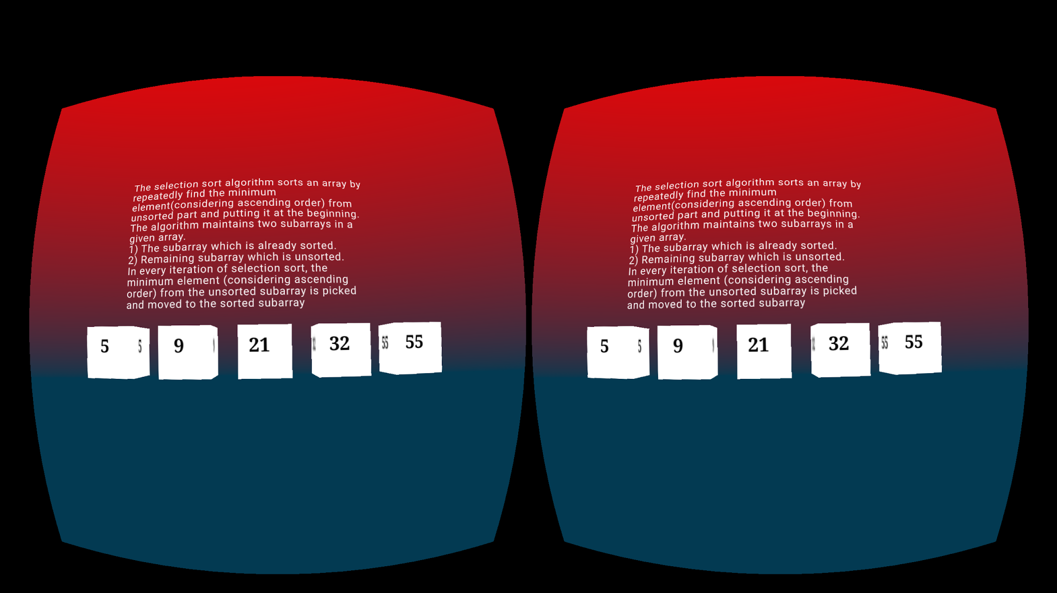
Project definition
The main focus of the project is to visualize computer science topics through the use of augmented and virtual reality technologies
WebVR Scenes : Education - Selection Sort Scene
Notes:
10 seconds.
Introduce the problem that the whole project (in all versions) tackles with GIF or screenshot.

Slide 3
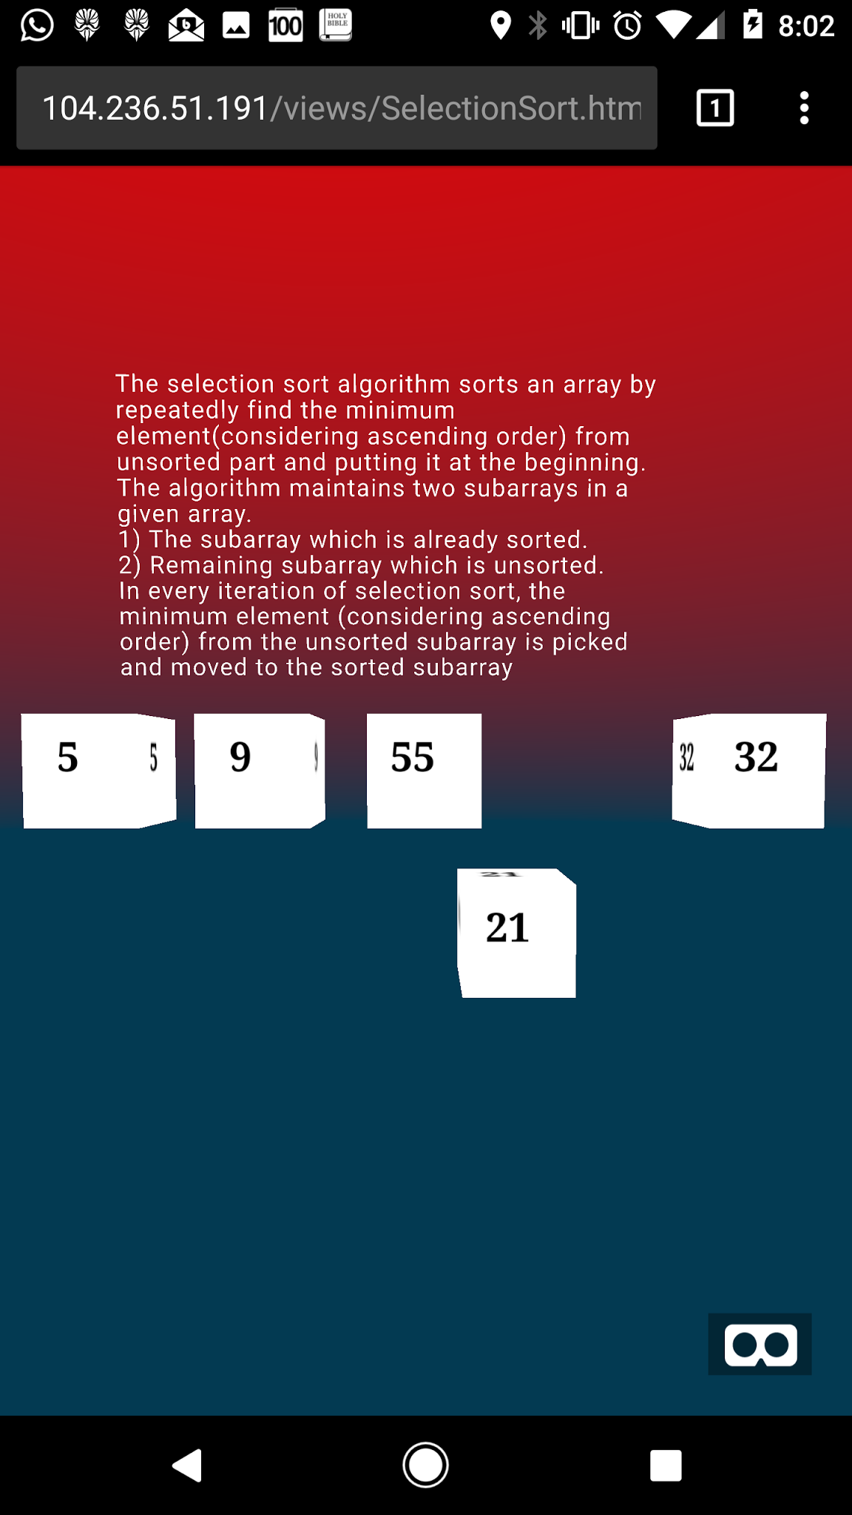
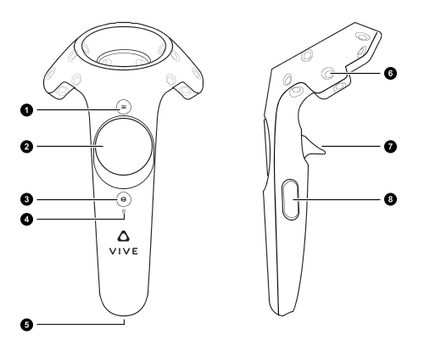
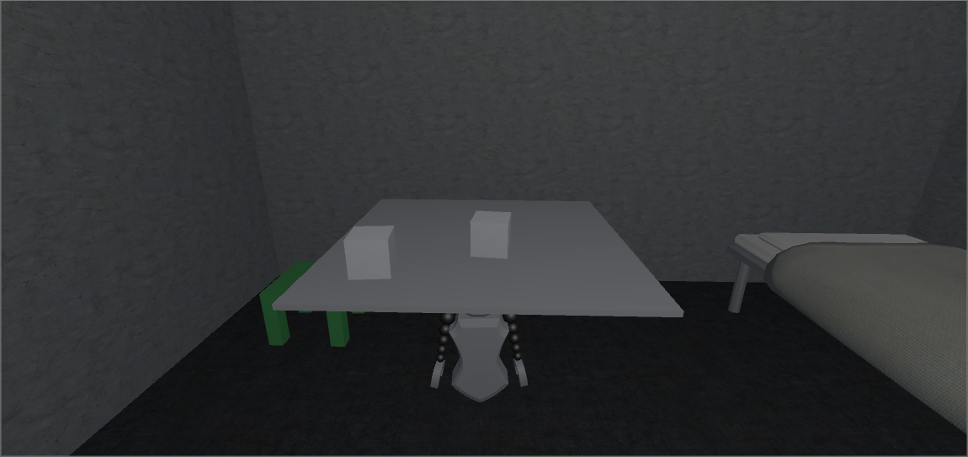
Project definition
Three different teams worked together to bring the project to life:
Education team focused on aiding in increasing the retention rate of Computer Science students.
Video Game team focused on incorporating programming concepts a virtual reality video game
Input team focused on integrating with different applications and support a variety of input devices such as virtual reality devices.
Notes:
20 seconds.
Introduce the problem that the your project (in new version) tackles with GIF or screenshot.

Slide 4
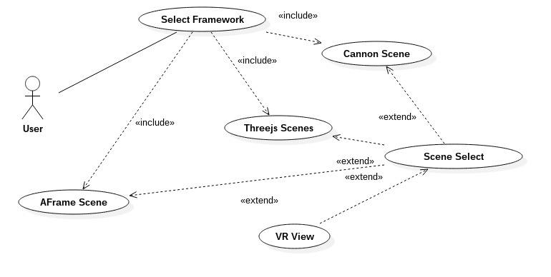
Requirements: Use Cases
System Use Case For Web-VR Education
Notes:
5 seconds
Show the Use Case Diagram for the whole project. Highlight your use cases.

Slide 5

System Design: Architecture
Software Requirements:
Chromium Web Browser, Visual Studio, Firefox Dev. Browser
A-Frame Web-VR Framework, Web-VR API
NPM, GULP, UNITY, Cannon JS Web-GL Library
Cargo, Rust Compiler, Windows 8, Ubuntu 16.04, Mac OS Sierra
Hardware Requirements:
Google Cardboard, Nexus 6P Phone, Occulus Rift
M502 Mouse, Playstation Controller, ACER 19” Touchscreen
16gb RAM, i7 Quad Core, NVIDIA GEFORCE Graphics Card
Notes:
20 seconds
System design: Highlight the parts that you contributed to them.
1. System decomposition; identify the architecture patterns used
2. System deployment – h/w and s/w requirements

Slide 6
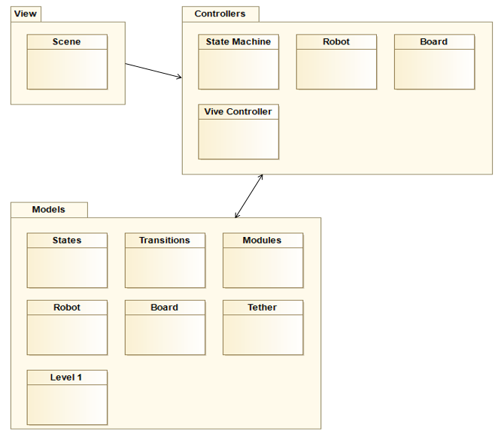

Minimal Class Diagram
Patterns observed
Model: Manages the data, logic and rules of the application entities.
View: Layer between model and controller which is manifested as User Interface
Controller: Handles communication and functionality between model and view layer.
Notes:
10 seconds.Minimal class diagram. Highlight the classes that you created/modified
Identify the design patterns used (one or more slides).

Slide 7
User Stories
#681 Selection Sort Algorithm Scene
2. #767 Dynamic stack interface scene
3. #673 Module collision detection
4. #752 Video Game Controller
5. #758 Generic Empty Device Implementation
Notes:
5 seconds.
List the user stories that you worked on them.(put in order of importance). Stay focused on the parts that you have been working.

Slide 8
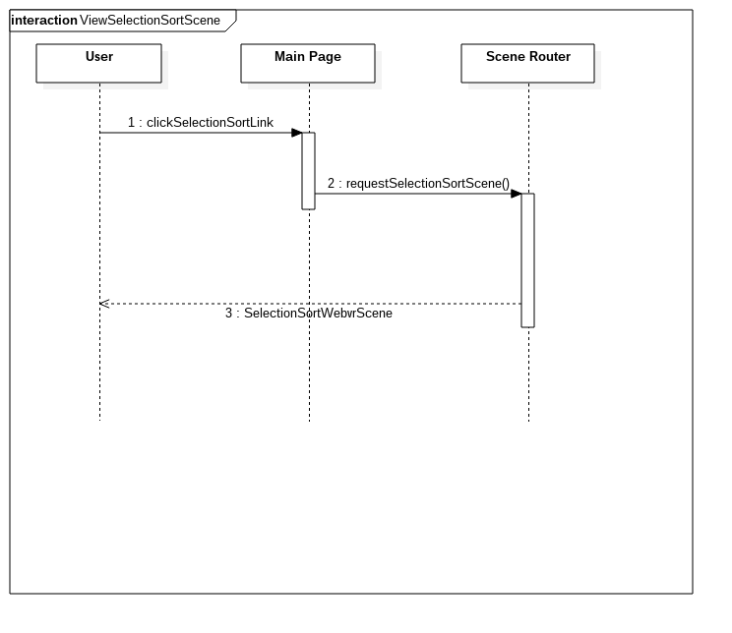
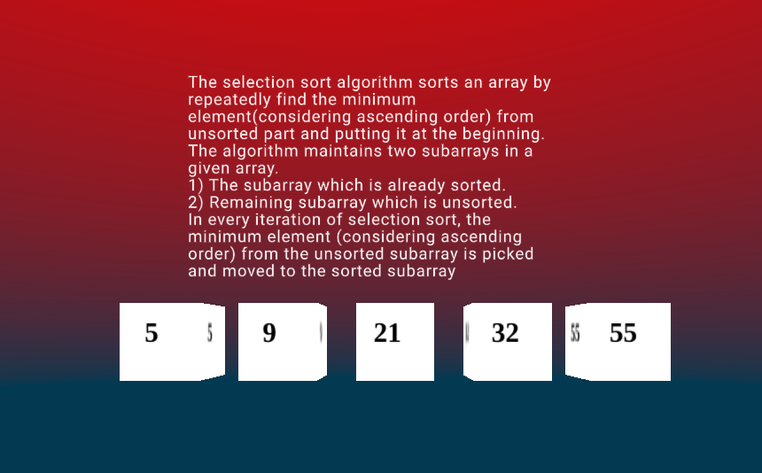
User Story #681 Selection Sort Algorithm Scene
This user story provided a means to see sorted using Selection Sort in order to gain a better understanding of the algorithm
Notes:
60 seconds
The tile of user story
The most important user story you worked on it. You have to describe this one very well and be proud of that.
Please present and show the complexity of your work, code, algorithms, and technical challenges and technologies you have used. (you could use screenshot if you want. Visual presentations are better than text presentation)
Go into the details of the most important/significant tasks using bullet lists or visual graphs or state chart diagram
Sequence Diagram for this user story is mandatory (in another separate page if required)
Demo using screenshots or GIF (in another separate page if required)

Slide 9
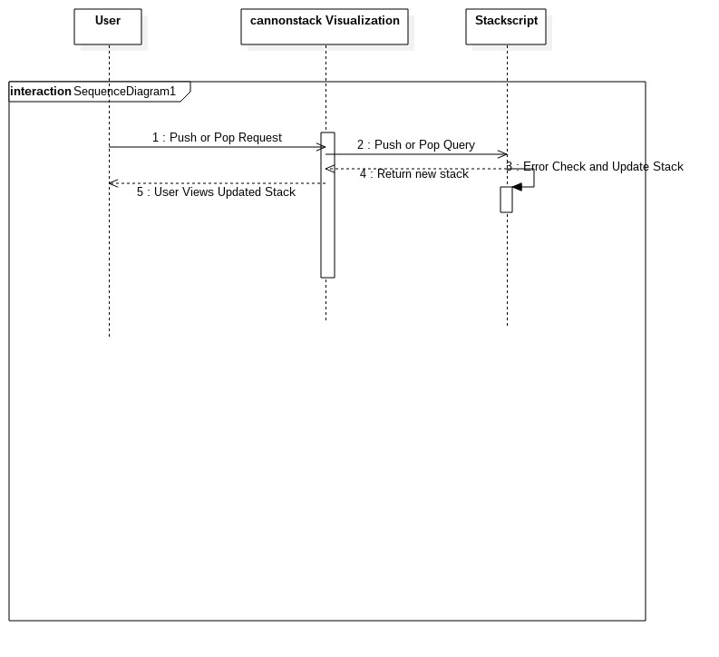
User Story #767 Dynamic stack interface scene
The user accesses the visual demo and then gets to push boxes onto a stack and pop boxes off afterward. If the stack is empty and the user requests to pop, an error message returns
Notes:
20 seconds
The tile of user story
Please present and show the complexity of your work, code, algorithms, and technical challenges and technologies you have used. (you could use screenshot if you want. Visual presentations are better than text presentation) - Go into the details of the most important/significant tasks using bullet lists or visual graphs or state chart diagram - Demo using screenshots or GIF (in another separate page if required)
Sequence Diagram for this user story is optional

Slide 10
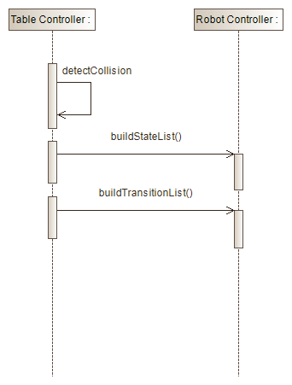
User Story #673 Module collision detection
This provides a user who plays this game with a robot that is able to detect modules that are placed on its programming board so that the user can give commands to the robot.
Notes:
20 seconds
The tile of user story
Please present and show the complexity of your work, code, algorithms, and technical challenges and technologies you have used. (you could use screenshot if you want. Visual presentations are better than text presentation) - Go into the details of the most important/significant tasks using bullet lists or visual graphs or state chart diagram - Demo using screenshots or GIF (in another separate page if required)
Sequence Diagram for this user story is optional

Slide 11
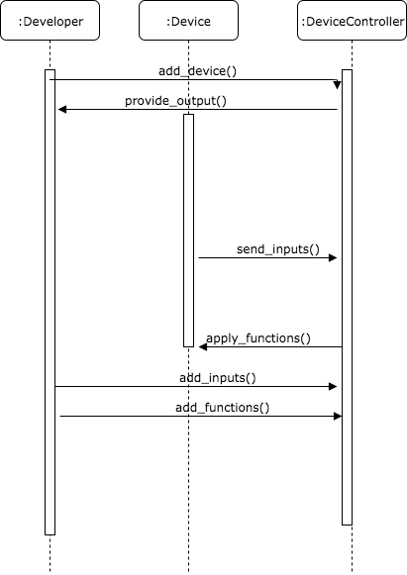
User Story #752 Video Game Controller
This provides developers with a modular interface to connect a video game controller to any computer and have it be usable. The controller also provides meaninful output based on the developer’s requests.
Notes:
20 seconds
The tile of user story
Please present and show the complexity of your work, code, algorithms, and technical challenges and technologies you have used. (you could use screenshot if you want. Visual presentations are better than text presentation) - Go into the details of the most important/significant tasks using bullet lists or visual graphs or state chart diagram - Demo using screenshots or GIF (in another separate page if required)
Sequence Diagram for this user story is optional

Slide 12
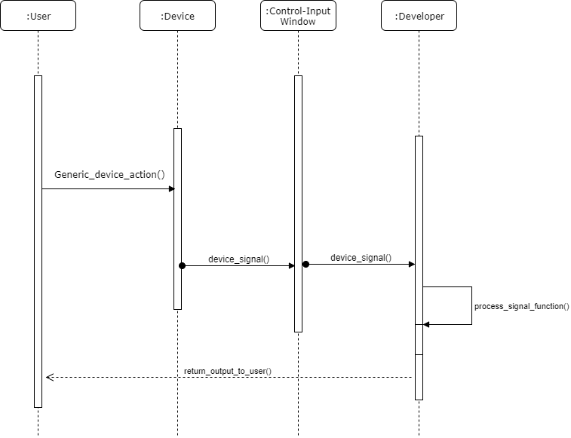
User Story #758 Generic Empty Device Implementation
This provides developers with a means to create a class in rust to handle generic or “unsupported” devices, so that the library can support as many devices as possible.
Notes:
20 seconds
The tile of user story
Please present and show the complexity of your work, code, algorithms, and technical challenges and technologies you have used. (you could use screenshot if you want. Visual presentations are better than text presentation) - Go into the details of the most important/significant tasks using bullet lists or visual graphs or state chart diagram - Demo using screenshots or GIF (in another separate page if required)
Sequence Diagram for this user story is optional

Slide 13
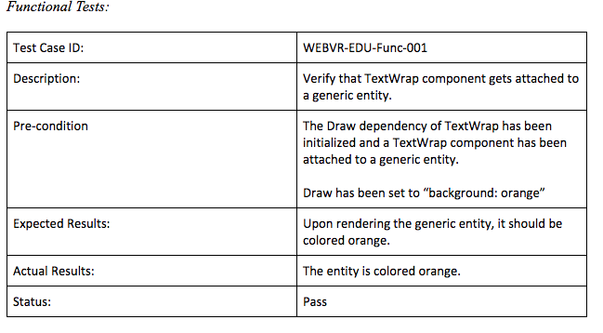
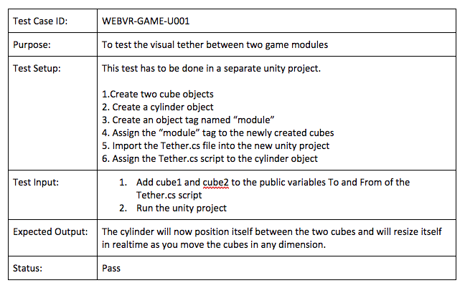
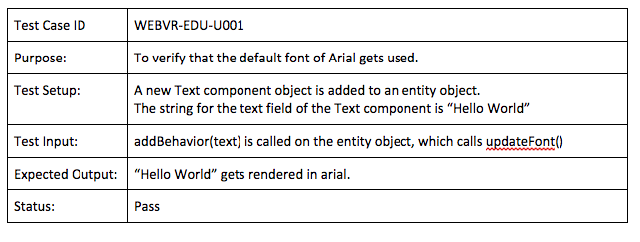
Test Suites and Test Cases
Each team wrote systems, subsystems, and unit tests. Below are a few
Notes:
10 seconds
A description of verification process and Test Suites and Test Cases for one of the use cases.
1 One sunny day and one rainy day for the implemented use cases (one or more slides).
2 Automated test scripts for the implemented use cases (if any) (one or more slides).

Slide 14



Summary
WebVR - 1.0 establishes the foundation for future development. The HID library, developed by Bernardo & Pachev sets the next step for integrating basic interface devices with WebVR-api in the Servo browser.
Daniel K. and Hamilton used a combination of Javascript libraries and frameworks to present different solutions to what can be implemented at the moment with the WebVr api.
Daniel R. used the Unity engine along with the HTC Vive to create a virtual reality game while subliminally introducing programming concepts to the user.
To exercise teamwork we held daily scrum meetings and used Mingle to keep track of our progress.
All of our documentation and source code can be found on our Github repository.
Notes:
10 seconds
Summarize your contribution, mention your effort for Scrum, Mingle, Github, Google Drive Documentation and minutes
Include your contact information
Ask if anyone has any questions for you.
Thank your audience

Slide 15
Contact Information
Hamilton Chevez: hchev001@fiu.edu
Pachev Joseph: pjose031@fiu.edu
Bernardo Pla: bpla003@fiu.edu
Daniel Rivero: drive076@fiu.edu
Daniel Khawand: dkhaw001@fiu.edu

Slide 16
Questions?
Notes:
10 seconds
Summarize your contribution, mention your effort for Scrum, Mingle, Github, Google Drive Documentation and minutes
Include your contact information
Ask if anyone has any questions for you.
Thank your audience

Slide 17
Thank You!
Notes:
10 seconds
Summarize your contribution, mention your effort for Scrum, Mingle, Github, Google Drive Documentation and minutes
Include your contact information
Ask if anyone has any questions for you.
Thank your audience

